Slide 1
Service Learning
Vivek Garg
CSVTU Bhilai

Slide 2
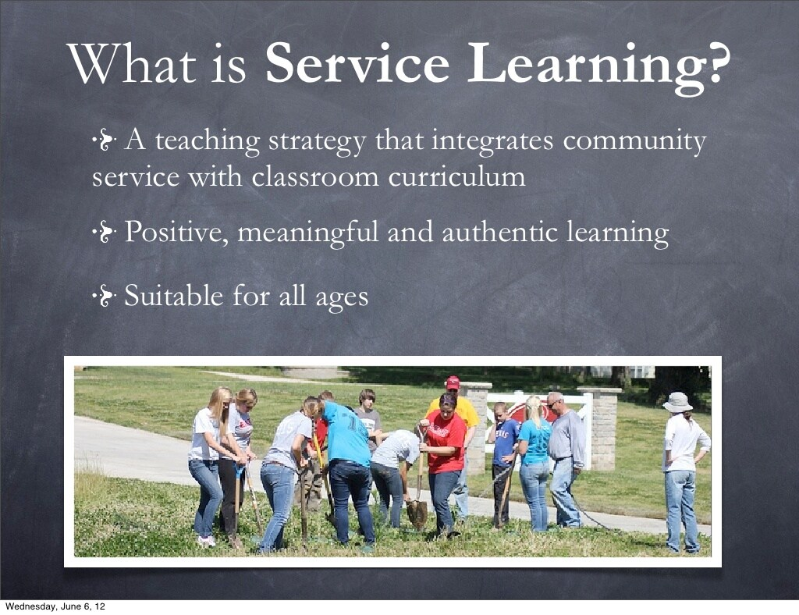

Slide 3
Service Learning
Service learning refers to learning the service policies, procedures, norms, and conditions, other than ‘the technical trade practices’. The service learning includes the characteristics of the work, basic requirements, security of the job, and awareness of the procedures, while taking decisions and actions. It helps the individuals to interact ethically with colleagues, to effectively coordinate with other departments, to interact cordially with suppliers as well as the customers, and to maintain all these friendly interactions.
The service learning is a methodology falling under the category of experiential education. It is one of the forms of experiential learning and community service opportunities. It is distinguished in the following ways:
1. Connection to curriculum: Integrating the learning into a service project is a key to successful service learning. Academic ties should be clear and built upon existing disciplinary skills.
2. Learner’s voice: Beyond being actively engaged in the project, trainees have the opportunity to select, design, implement, and evaluate their service activity.
3. Reflection: Structured opportunities are created to think, talk, and write about the service experience. The balance of reflection and action allows the trainee to be constantly aware of the impact of their work.
4. Partners in the community: Partnership with community agencies are used to identify genuine needs, provide mentorship, and contribute input such as labor and expertise towards completing the project.

Slide 4
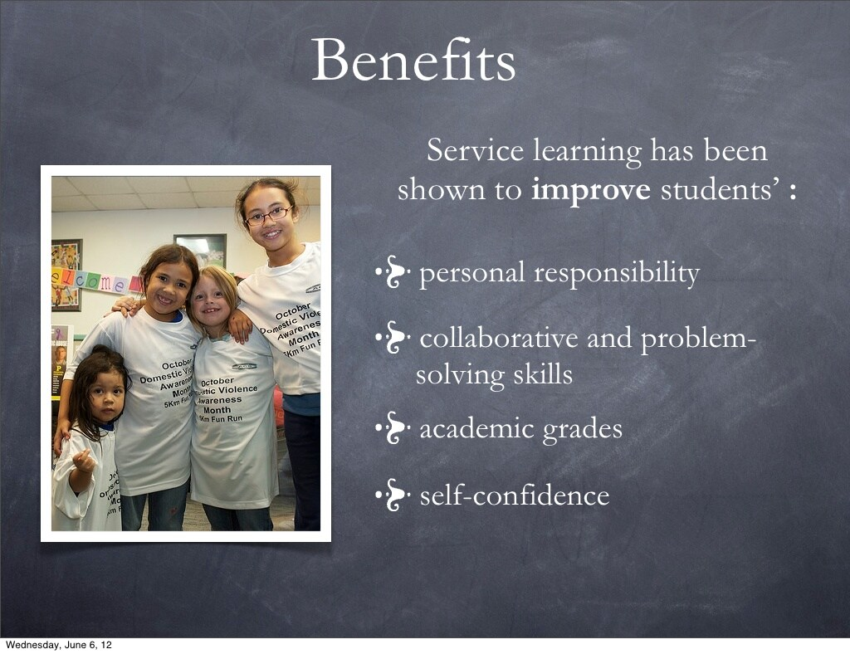

Slide 5
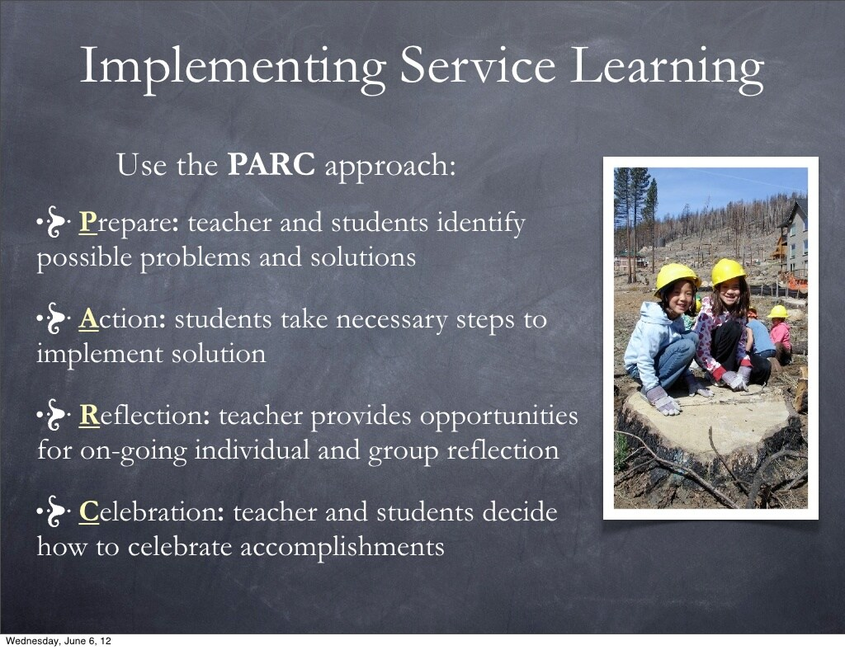

Slide 6
